Slide 1
SAFE PAWS
TEAM FOXTROT
MIDSEMESTER PRESENTATION
ECE - Capstone Design 1

Slide 2
Safe Paws
OVERVIEW
1 Introduction
2 Problem
3 Design Plan
4 Analysis
5 Timeline
6 Conclusion

Slide 3



1
Our
Team
Nathan Phan
Team / Sensors Lead
Victor Gonzalez
Terry Jenkins
Communications Systems
Data Systems

Slide 4



1
Our
Team
DeArirreis Vance
Software
Clayton Lott
Vuk Marojevic
Power Systems
Faculty Advisor

Slide 5
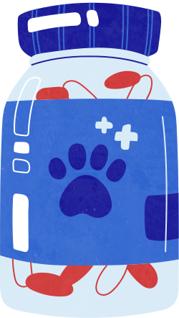
2
Safe Paws
PROBLEM
Problem
Owners can lead busy lives, with work, family, and social commitments, leaving limited time for continuous monitoring of their dogs' health. [1]
Problem
Veterinary visits can be time-consuming, costly, and may not offer timely insights into a pet's health [1].
Problem
Current products on the market are complex and expensive, limiting accessibility for some owners [2].
Notes:
66% of US households own pets. Out of the 66%, about 65 mil owning dogs.

Slide 6

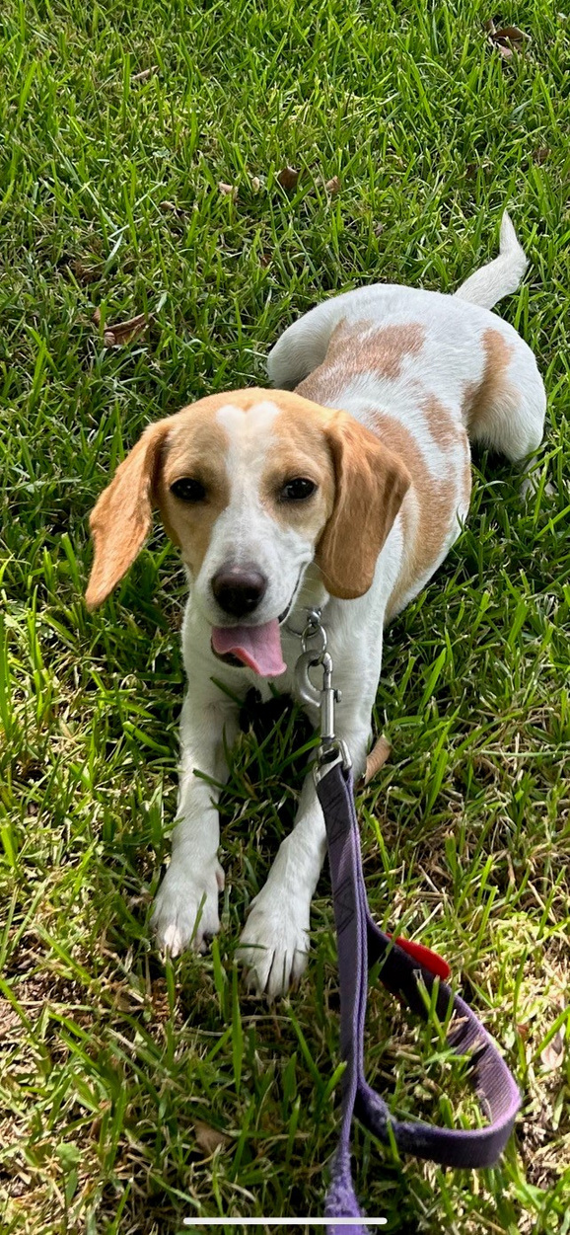
2
Safe Paws
TARGET AUDIENCE
Name: Alexis Nordin
Married, 2 Children
Occupation: Teacher
Sally-Beagle Mix
Age: 2
Health Issues: heartworms, currently being treated
Concerns: has to stay calm and relaxed

Slide 7
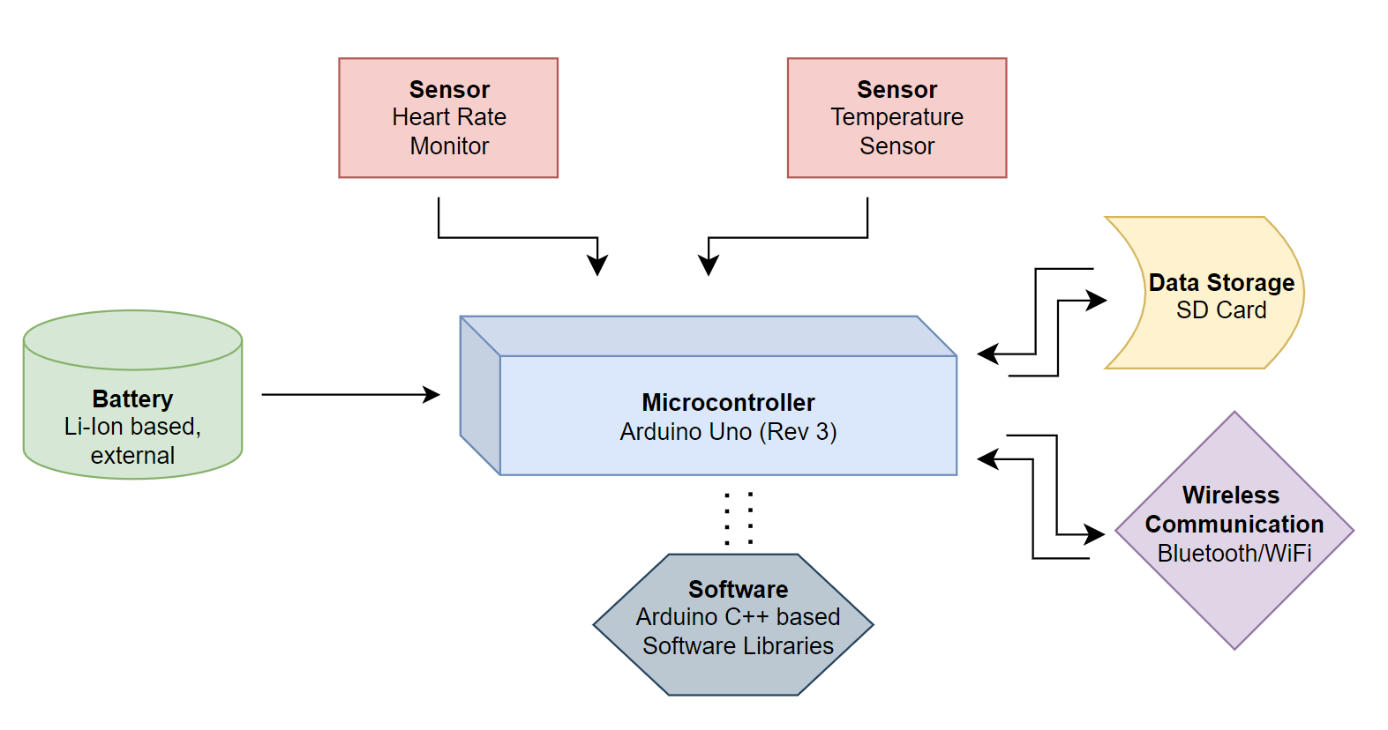
3
Safe Paws
DESIGN PLAN

Slide 8
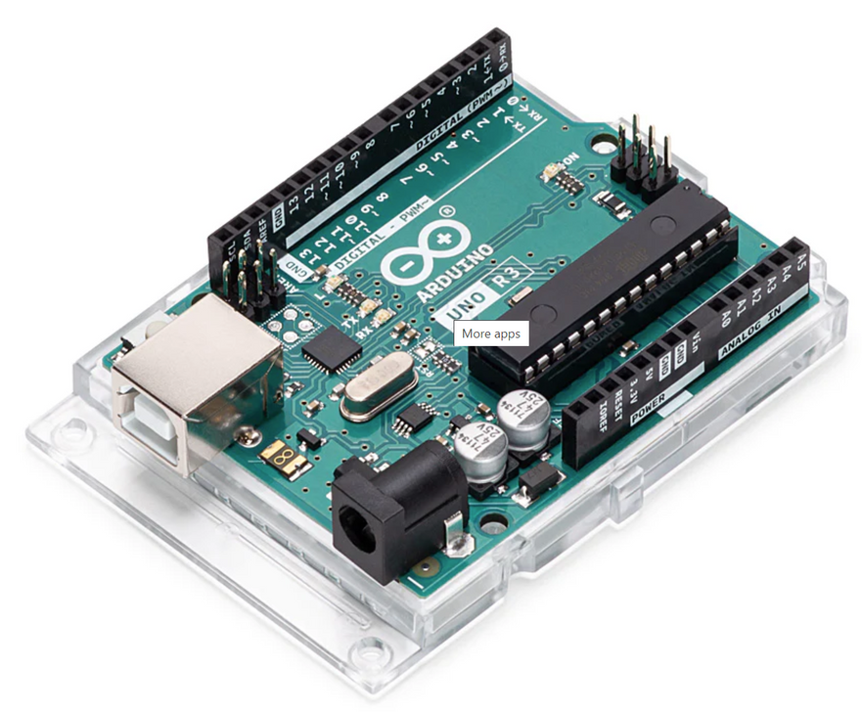
4
Safe Paws
Microcontroller
Arduino Uno
Arduino microcontrollers offer many advantages to our design system design [3].
Low-power requirement
Support for a wide-range of peripherals
SD Card I/O
WiFi/Bluetooth
Digital/analog sensor support
Well-supported software libraries
SD-FATLIB (FAT16/FAT32 file system)
ArduinoBLE (Bluetooth), ConnectionHandler (WiFi)
Alternatives considered:
Basys Board (HDL-based)
Raspberry Pi (less hardware support, dev-focused)
HARDWARE

Slide 9
4
Sensor | Price | Size | Voltage and Amp | Wavelength | Microcontroller
DS18B20 (Digital Thermometer) | $ 13.66 | length - 91cm diameter - 4 mm | 3.0 ~ 5.5VDD 1-1.5mA | Temperature range -55°C – 125°C | Arduino
Pulse Sensor (Photoplethysmography) | $ 24.99 | 4 x 0.5 x 6 in | 3.0 - 5.5V 4mA | LED output 565nm | Arduino
MAX3012 (Pulse Detection ppg) | $12.99 | 5.6mm x 3.3mm x 1.55mm | 3.3- 5V 20mA | LED output 660/880nm | Arduino
Sensors
Review
[4]
HARDWARE

Slide 10
Battery Type | Advantages | Disadvantages
Nickel Metal Hydride | Cheaper Medium weight Less memory (than Ni-Cd) | High charge loss over time only 500 cycles Low cell voltage
Nickel Cadmium | Cheaper 800 cycles on the low end | Heavy High charge loss over time Memory low cell voltage
Lithium Polymer | No memory lightweight Low charge loss over time | Less power density than Lithium Ion more expensive
Lithium Ion | No memory lightweight Low charge loss over time More power density | more expensive
Safe Paws
Battery
Analysis
We chose a 7.4V 2600mAh Rechargeable lithium ion Battery for our power needs. This is because it met all the criteria we needed, including voltage, reliability, rechargeability, and size.
[5]
POWER
4
Notes:
wrong wording for "mild memory"

Slide 11
4
Safe Paws
Initialize sensors module; Initialize data storage module; Initialize Bluetooth module;
SOFTWARE
Start
Measure readings from sensors;
If user requests live data view,
send the live data to the smartphone
Loop
Store in collected data structure;
If readings are beyond set range,
notify user
Wait for interval to begin collection again;
Pseudocode Approach

Slide 12




5
Safe Paws
TIMELINE
Sep 2023
Sep/Oct 2023
Oct 2023
Oct/Nov 2023
Problem
Research
Design
Testing
Understand the issues that need to be addressed with our project.
Ascertain how to solve each one of the problems.
Implement our design plan.
Testing of the be performed during each subsystem’s development,.

Slide 13
Additional Considerations
Software Library Usage
Licensing requirements (fine-print), if applicable
Editing/amending software libraries
Vest Design
Component location and installation
Ventilation, water-resistance, insulation, and padding.
Form follows function
Team Foxtrot
THANK YOU
ANY QUESTIONS PLEASE?

Slide 14
REFERENCES
[1] M. Megna, “Pet ownership statistics 2023,” Forbes, https://www.forbes.com/advisor/pet-insurance/pet-ownership-statistics/ (accessed Oct. 9, 2023).
[2] “Wearable Technology for Animals 2017-2027: Technologies, markets, forecasts,” IDTechEx, https://cdn.idtechex.com/en/research-report/wearable-technology-for-animals-2017-2027-technologies-markets-forecasts/488 (accessed Oct. 6, 2023).
[3] T. A. Team, “Uno R3,” Arduino Documentation, https://docs.arduino.cc/hardware/uno-rev3 (accessed Oct. 6, 2023).
[4] A. Kruzer, “What should a dog’s temperature, heart rate, and respiratory rate be?,” The Spruce Pets, https://www.thesprucepets.com/normal-temperature-heart-rates-in-dogs-4143223#:~:text=Heart%20Rates%20of%20a%20Dog%20%20%20,100%20BPM%20%20%20Over%20140%20BPM%20 (accessed Oct. 6, 2023).
[5] C. Resende, “Best Power Tool Battery types: NICD vs nimh vs Li-Ion vs Li-Polymer,” Best Power Tools For Sale, Expert Reviews and Guides, https://www.powertoollab.com/power-tool-battery-types/ (accessed Oct. 6, 2023).

